Slide 1
Weightlifting Service App - Demo
American Crystal Sugar (weightliftingapp.azurewebsites.net)
Published URL:
https://weightliftingapp.azurewebsites.net/weight-calculator
Git Repo URL:
https://github.com/dharanesha-kori/WeightliftingApp.git

Slide 2
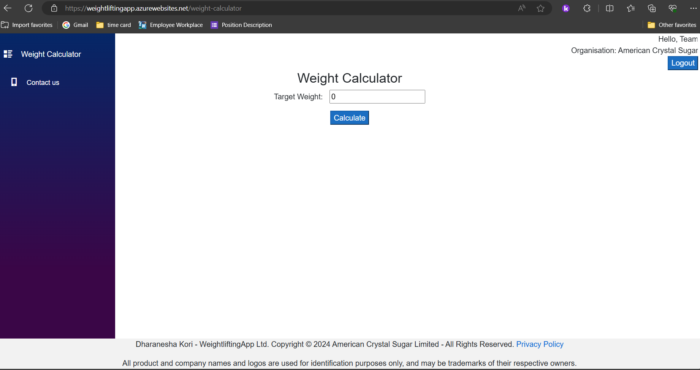

Slide 3
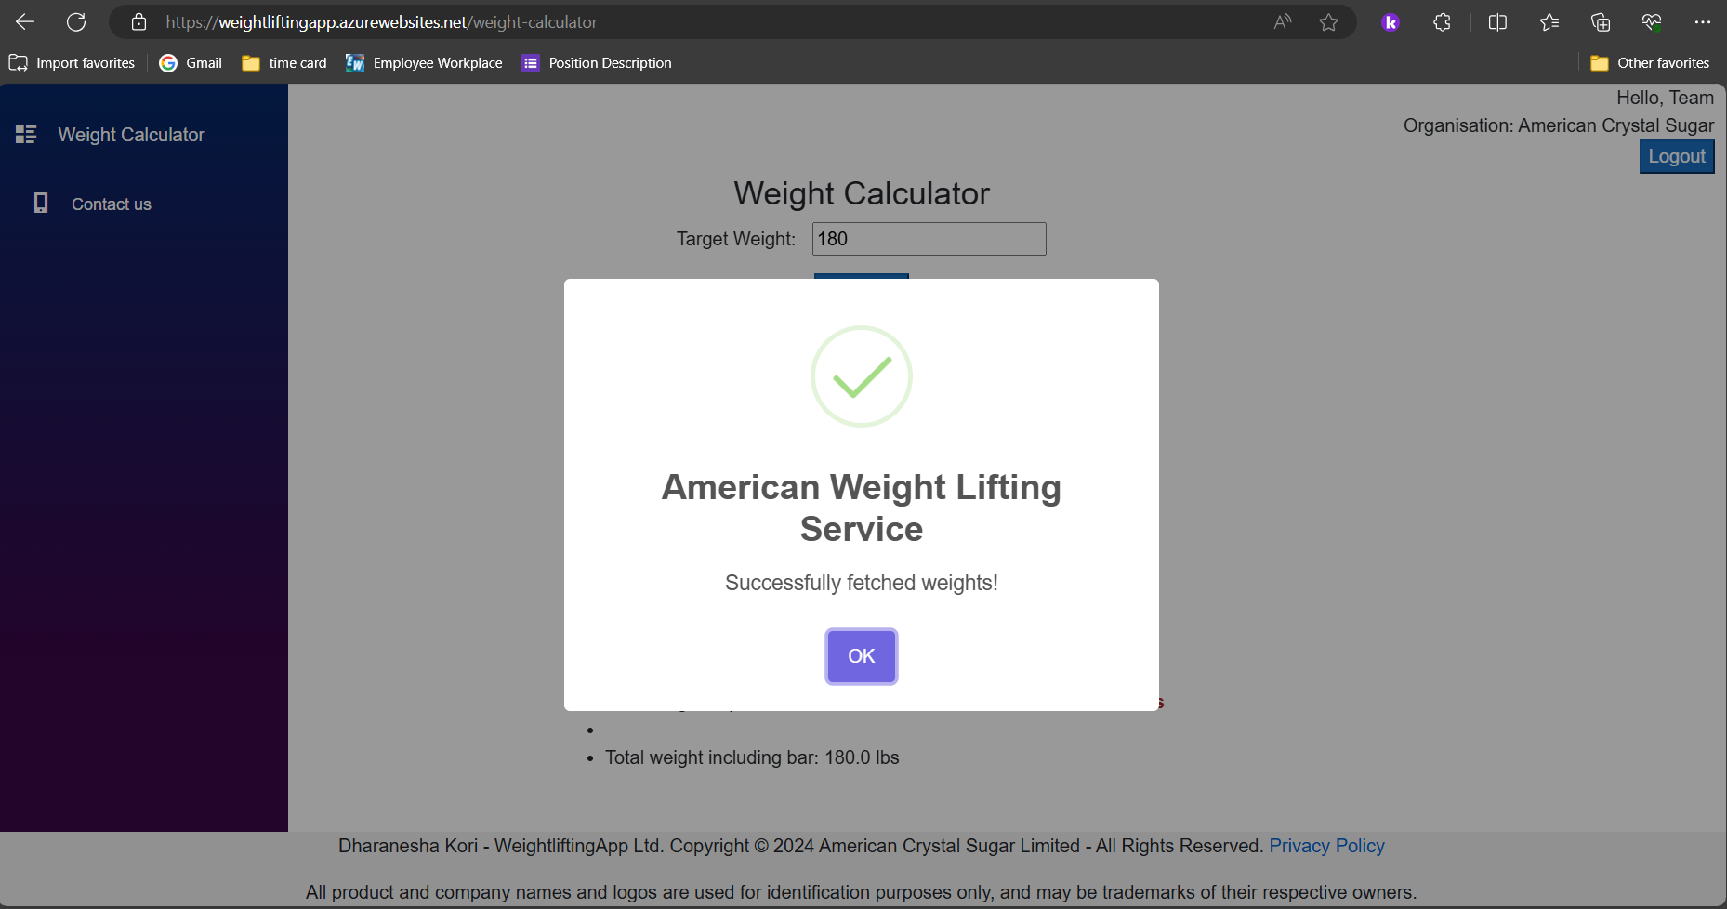

Slide 4
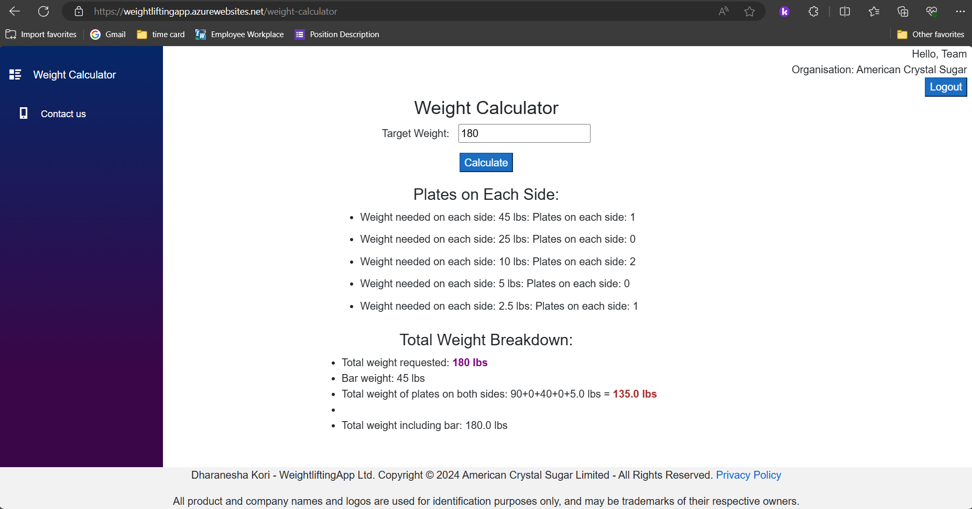

Slide 5
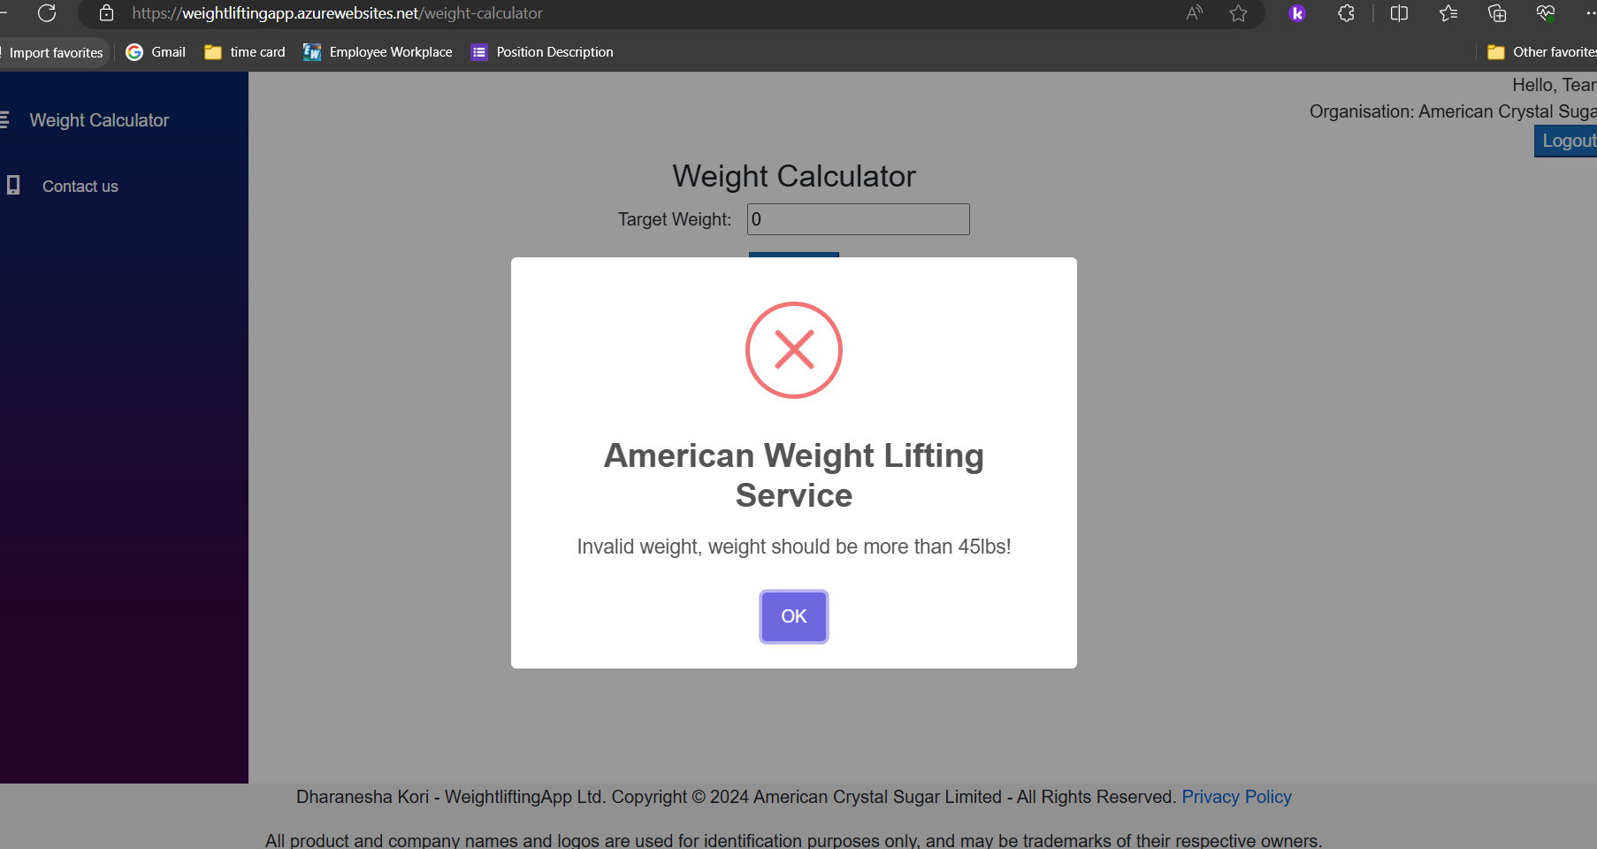

Slide 6
